Slide 1

Final Project
AI Bootcamp
April 22, 2024
FINAL PROJECT
April 22, 2049
AI Bootcamp

Slide 2
Project Summary
Project Goals
Extend our First Project
User Interface for Models
Find New Data
Plan Project
Assign Roles
Airbnb
Lexicographical sorting and decoding
K-means Model
Linear Regression Model
Restaurant
Feature Encoding
LLM Summarization
Cosine Similarity
Sightseeing
Open AI
LangChain
Prompt Engineering
Streamlit
Gradio
Results
Integrated Code
Working App in Gradio
FINAL PROJECT
April 22, 2049
AI Bootcamp
M.C. Squared Project 3 April 22, 2024

Slide 3
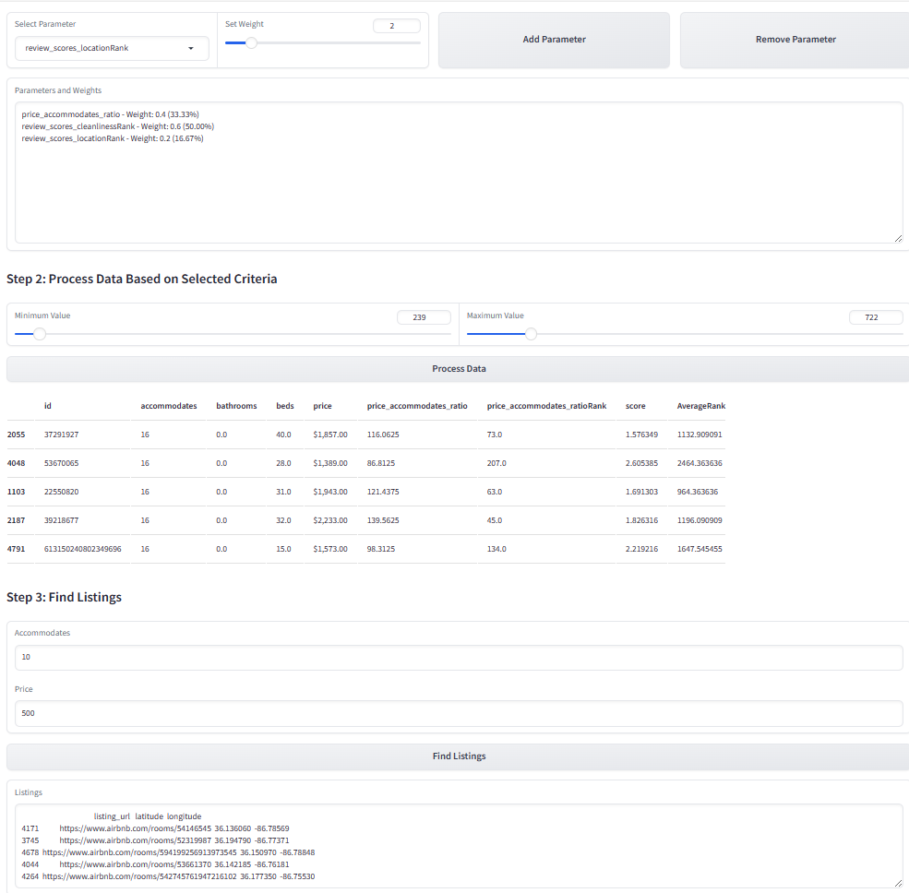
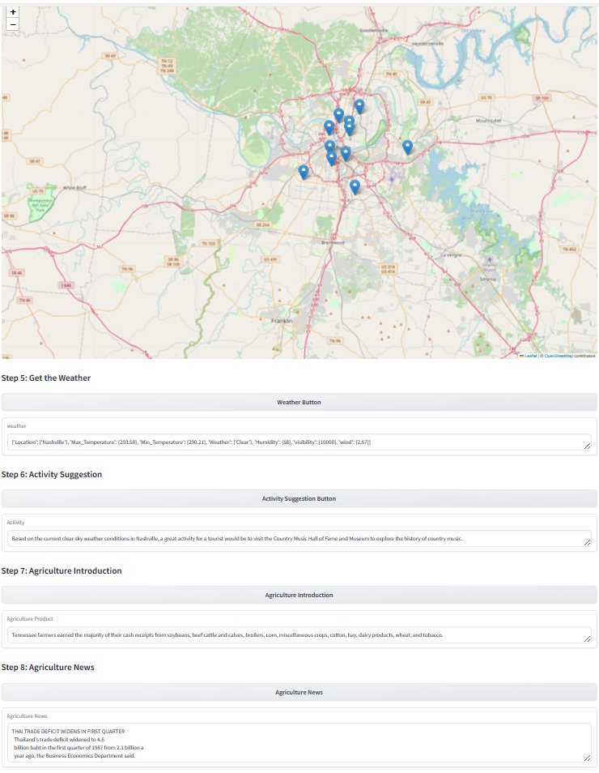
Airbnb Recommendations
Goal
Recommend Airbnb based on lexicographical sorting and decoding of listing in Nashville based on testing of customized model.
Challenges
Connecting reusable variables and data from one app to another app.
Approach/Results
Filter information by decoding to multiple rating scores and normalize data first in descending orders and then in ascending order based on other columns.
Step-by-step process to fetch different set of data and reuse it from one app to another.
FINAL PROJECT
April 22, 2049
AI Bootcamp
M.C. Squared Project 3 April 22, 2024

Slide 4
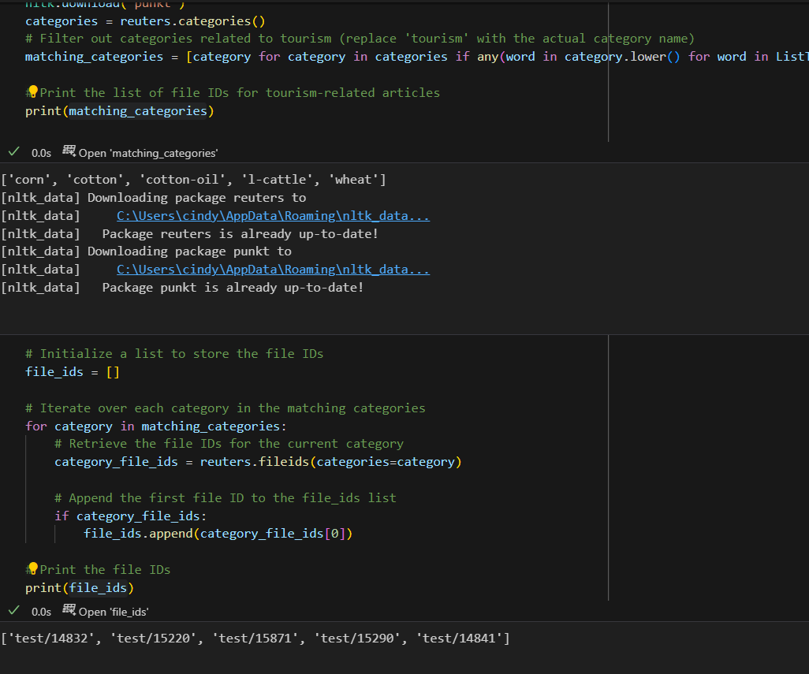
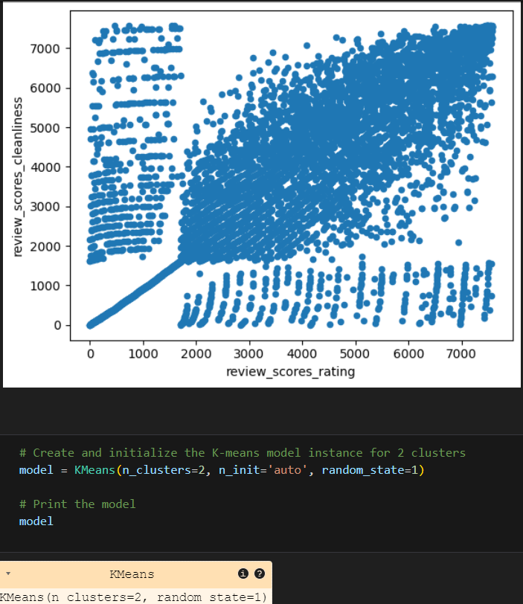
Airbnb Recommendations
Training the Models
K-means Model training and analysis of the data
Linear Regression Model
Review of Cindy’s Code
FINAL PROJECT
April 22, 2049
AI Bootcamp
M.C. Squared Project 3 April 22, 2024

Slide 5
Restaurant Recommendations
Goal
Recommend restaurants that fit a user’s general preferences, without using a rules-based approach.
Challenges
Cold-Start – we don’t have profiles of our user, or other users.
Approach
Initially tried to train a neural network but couldn’t determine a suitable way to provide specific restaurants as the target.
Finally arrived at utilizing cosine similarity, to evaluate the proximity of a users desired restaurant to the options available.
FINAL PROJECT
April 22, 2049
AI Bootcamp
M.C. Squared Project 3 April 22, 2024

Slide 6

Restaurant Recommendations
The Data
Yelp provides an academic dataset of JSON-structured business profiles, photos, reviews, and more.
Some elements of this data were larger-than-RAM and had to be processed in chunk.
FINAL PROJECT
April 22, 2049
AI Bootcamp
M.C. Squared Project 3 April 22, 2024

Slide 7

Restaurant Recommendations
Future Ideas
Integrate with Yelp’s live API.
Build retrievable user profiles, collecting individualized feedback.
FINAL PROJECT
April 22, 2049
AI Bootcamp
M.C. Squared Project 3 April 22, 2024

Slide 8
Sightseeing Recommendations
Goal
Provide user with list of sightseeing activities.
Approach:
Keep is simple and add functionality.
Challenges
Prompting and output were glitchy at first.
Form over function caused rework which took more time than expected.
Lost some features in the process.
FINAL PROJECT
April 22, 2049
AI Bootcamp
M.C. Squared Project 3 April 22, 2024

Slide 9
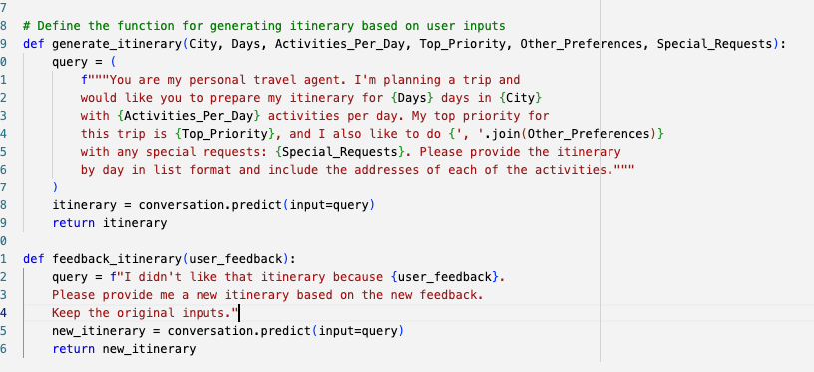
Sightseeing Recommendations
Sightseeing Details
Openai API (gpt-3.5-turbo) Model
LangChain Chains, Memory, Memory Prompt from Entity_Memory Conversation Template
Prompt Engineering
FINAL PROJECT
April 22, 2049
AI Bootcamp
M.C. Squared Project 3 April 22, 2024

Slide 10
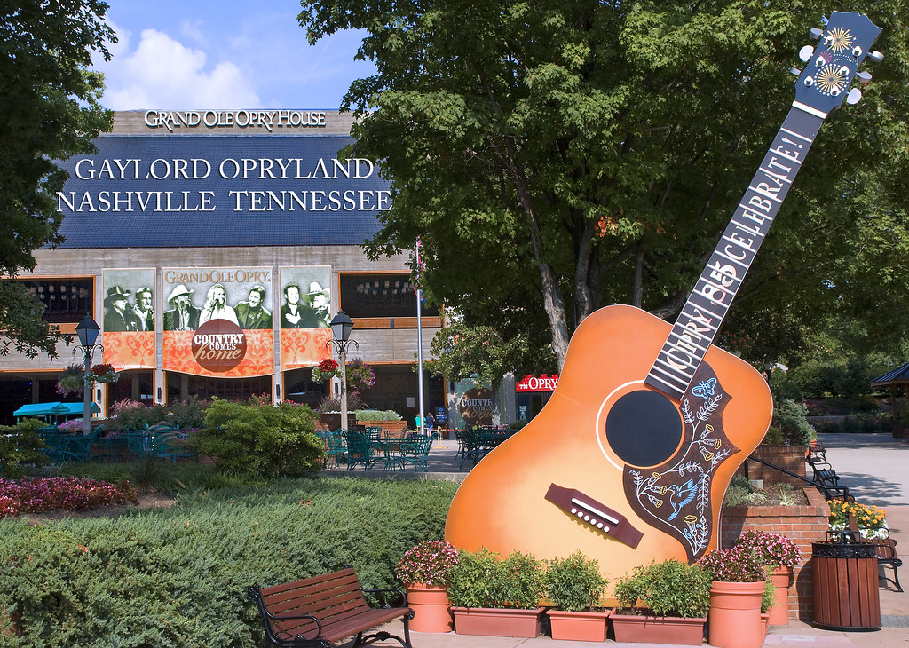
Sightseeing Recommendations
Future Ideas
Visuals – add pictures of sightseeing venues & move weather from Airbnb to Sightseeing.
Improve Itinerary – interaction with check boxes to pick which to keep.
Update User Interface to Streamlit – I found it more flexible & better looking.
FINAL PROJECT
April 22, 2049
AI Bootcamp
M.C. Squared Project 3 April 22, 2024
This Photo by Unknown Author is licensed under CC BY

Slide 11

Team Assessment
Self Assessment
What We Learned From Previous Projects & How We Stacked Up | Matt | Cindy | Christine
Define Project & Assign Roles – Minimize Scope Creep | 4/5 |  | 3/5
Start Small – Manageability of Data and Project Goals | 5/5 |  | 5/5
Develop Calendar – Minimize All Nighters | 4.5/5 |  | 4/5
Communication – Ensure We Are Rowing Same Direction | 3.5/5 |  | 3.5/5
FINAL PROJECT
April 22, 2049
AI Bootcamp
M.C. Squared Project 3 April 22, 2024

Slide 12

Now, for the Demo!
M.C. Squared Project 3 April 22, 2024

